Slide 1

Airbnb Hotel Booking Analysis
[Nimisha Rawat ]
[Internship ID:INTERNSHIP_172663295366ea53f910591]

Slide 2

PROBLEM STATEMENT
Airbnb Hotel Booking Analysis
Airbnb has revolutionized the hospitality industry by connecting travelers with diverse lodging options worldwide. With its expanding listings and user base, analyzing booking data is essential for hosts to optimize earnings and for Airbnb to improve user experience. This project focuses on studying booking patterns, pricing, guest preferences, and host performance to uncover insights that enhance decision-making and guest satisfaction.

Slide 3
Project Description
This project aims to analyze Airbnb booking data to uncover trends and insights that can benefit hosts, guests, and the platform itself. By examining booking behaviors, pricing strategies, guest preferences, and host performance, the analysis seeks to improve decision-making, maximize host earnings, and enhance the guest experience.
Key Objectives:
Booking Patterns – Identify peak seasons, regional booking variations, and average lead times.
Pricing Strategies – Analyze effective pricing methods, the impact of seasonality, and how pricing affects guest satisfaction.
Guest Preferences – Discover the most desired amenities and factors influencing high ratings.
Host Performance – Examine what top hosts do well, the role of responsiveness, and common guest complaints.
Future Scope:
Future Directions: Develop advanced predictive models, personalize guest recommendations, implement dynamic pricing strategies, and integrate external data sources.
The project can be expanded in the future through:
Predictive Analytics : forecast booking trends and pricing using machine learning.
Personalized Recommendations: for guests based on past behavior.
Dynamic Pricing Models: adjust rates in real time based on market demand and competition.
Geospatial Analysis: examine how location impacts bookings and guest preferences.
External Data Integration: events, weather, and economic trends to improve analysis accuracy.
Behavioral Analysis: study long-term host and guest behavior trends and identify shifts in the hospitality market.

Slide 4

WHO ARE THE END USERS?
Airbnb Hosts
Airbnb (Platform)
Prospective Hosts/Property Investors
Guests (Travelers)
Data Analysts & Researchers
Tourism & Hospitality Stakeholders

Slide 5

Technology Used
Programming Languages
Python: data analysis, visualization
Libraries
Pandas & NumPy: Data manipulation and preprocessing
Matplotlib & Seaborn: Data visualization
Plotly Express: interactive and dynamic charts
Platform: Google Colab
File handling libraries: openpyxl (for Excel) and built-in CSV handling

Slide 6
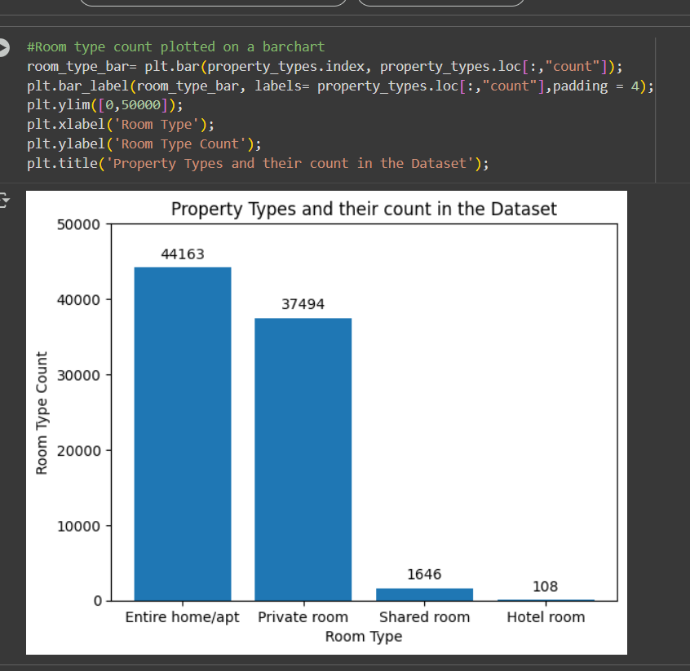
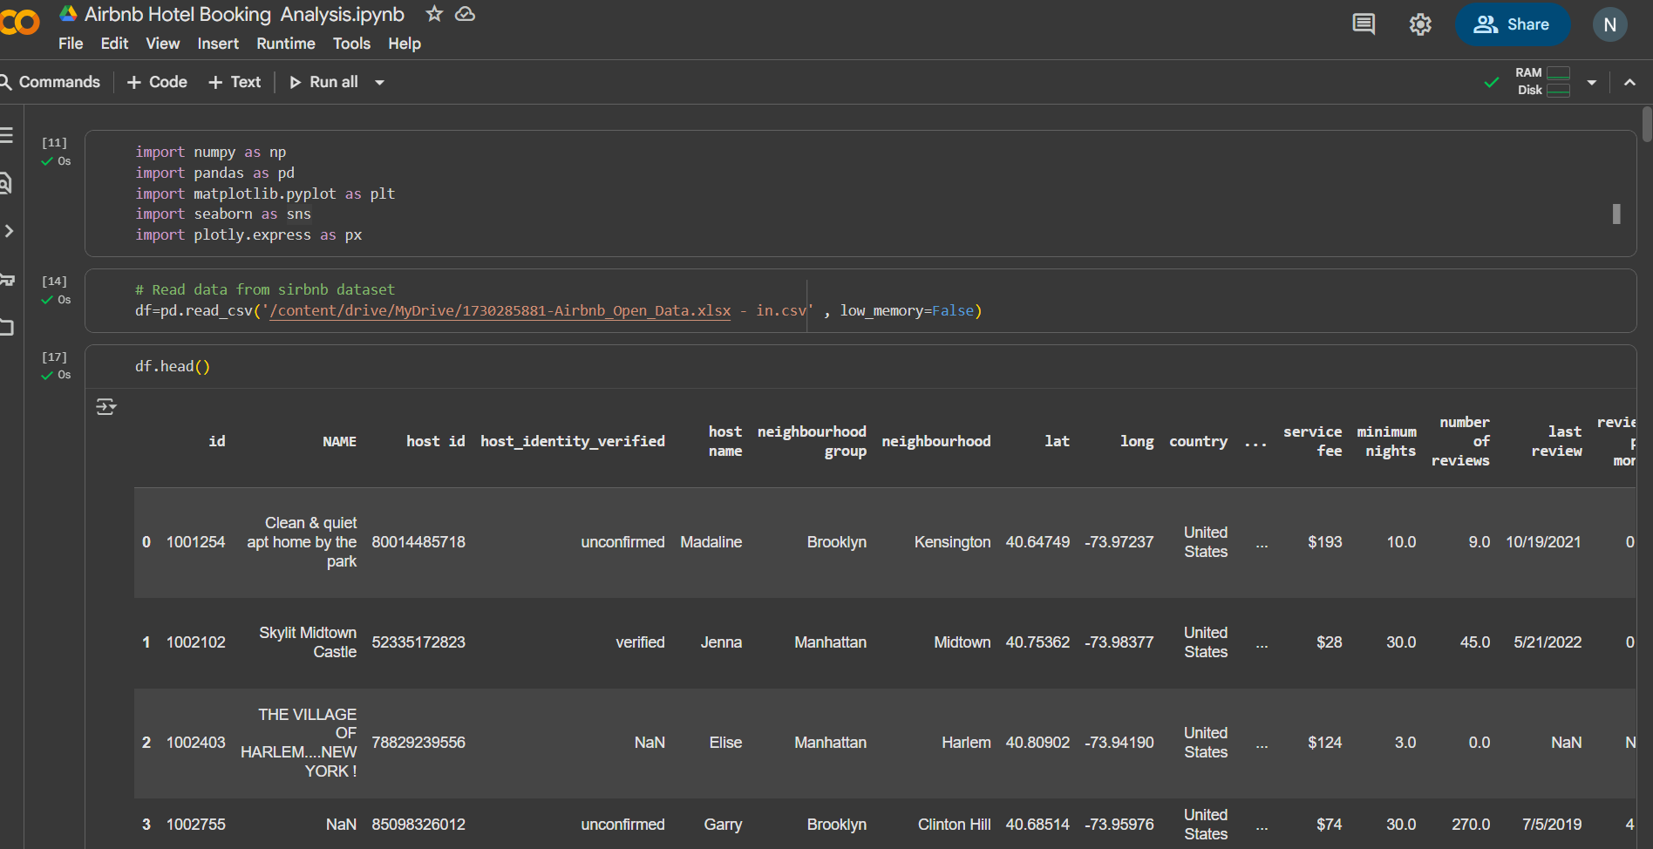
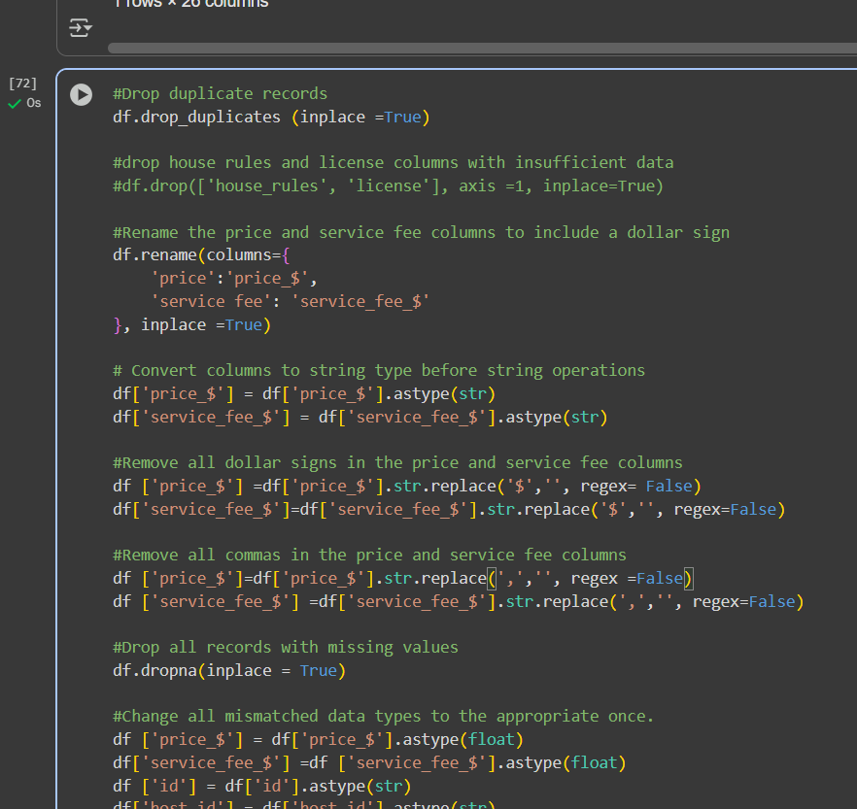
RESULTS1

Slide 7
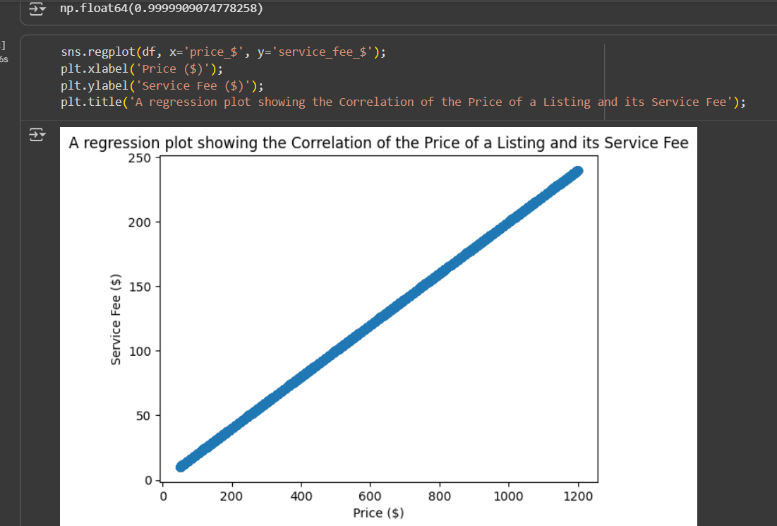
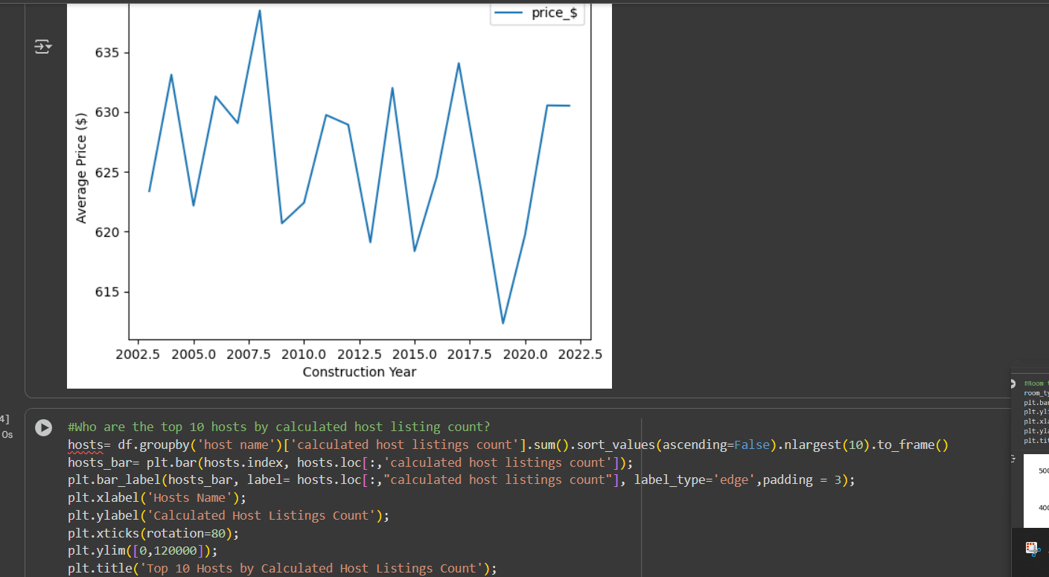
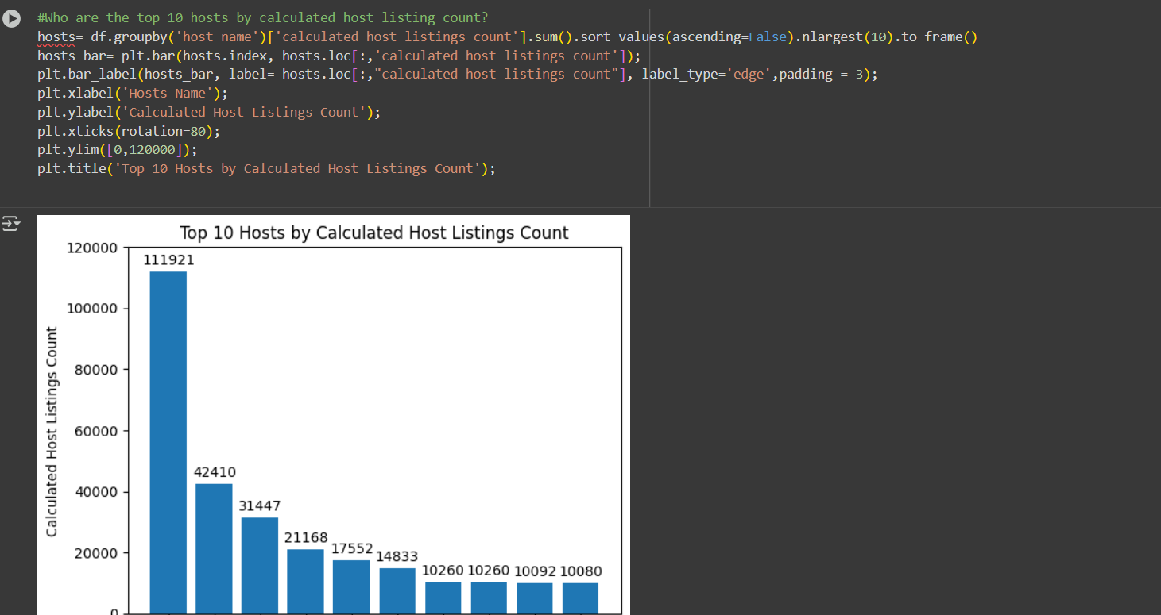
RESULTS2

Slide 8
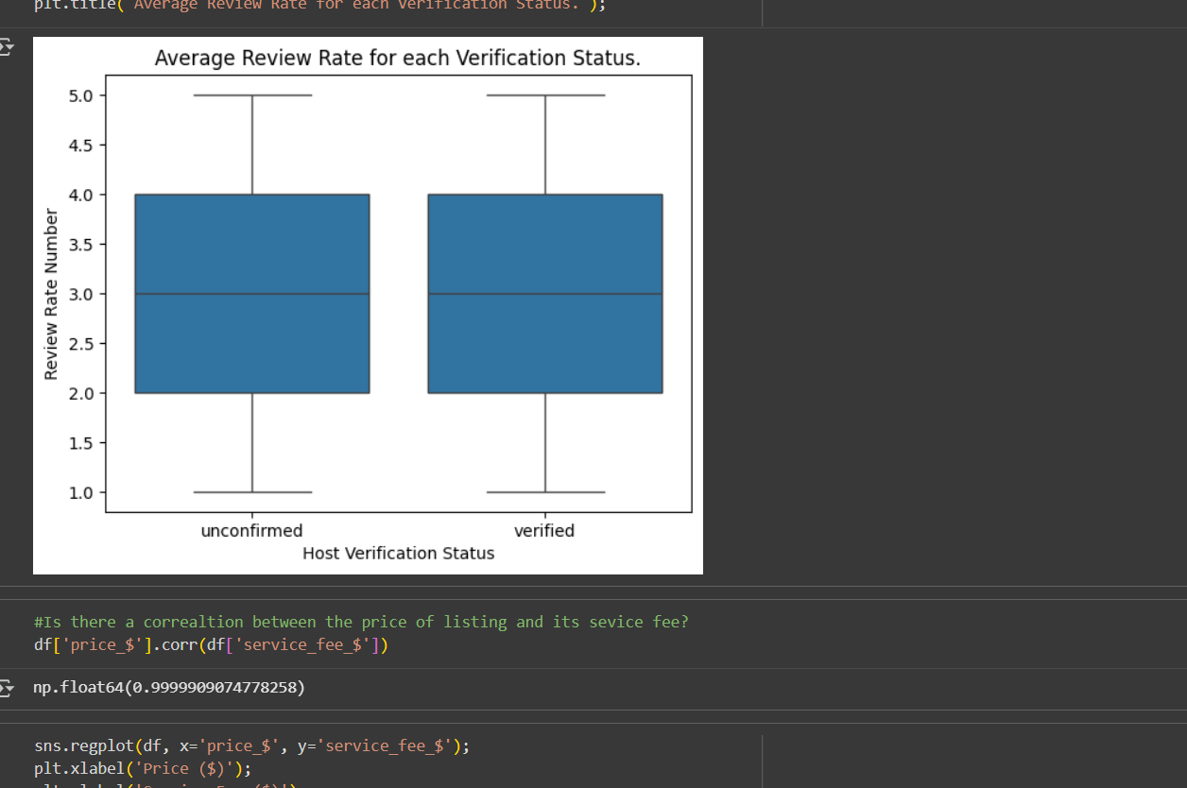
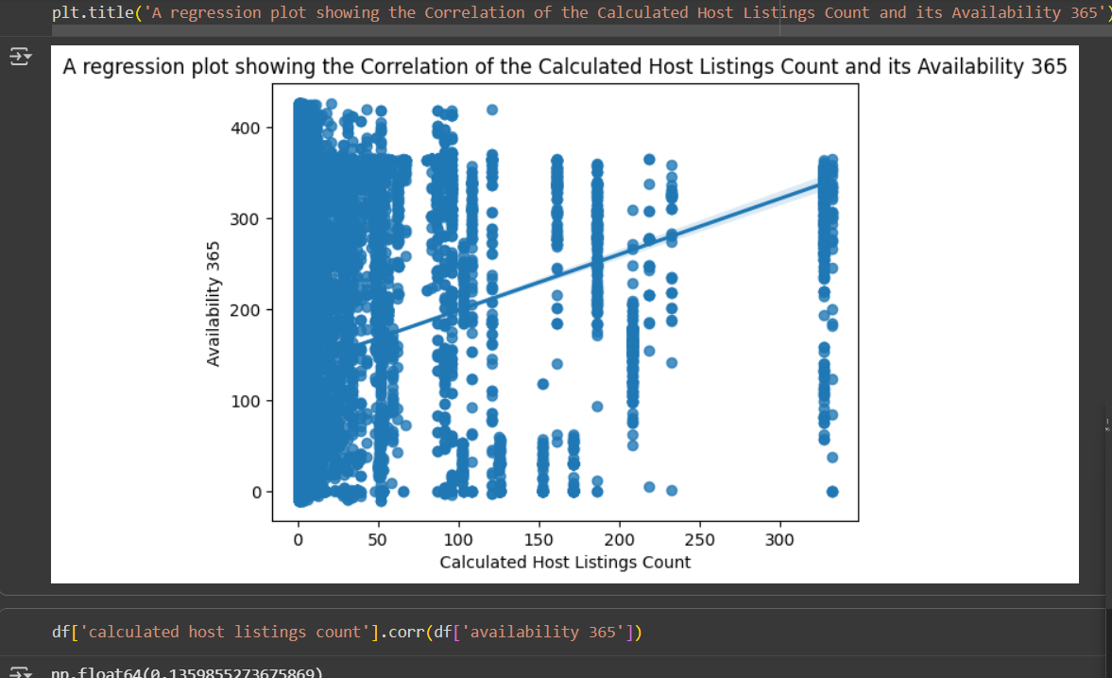
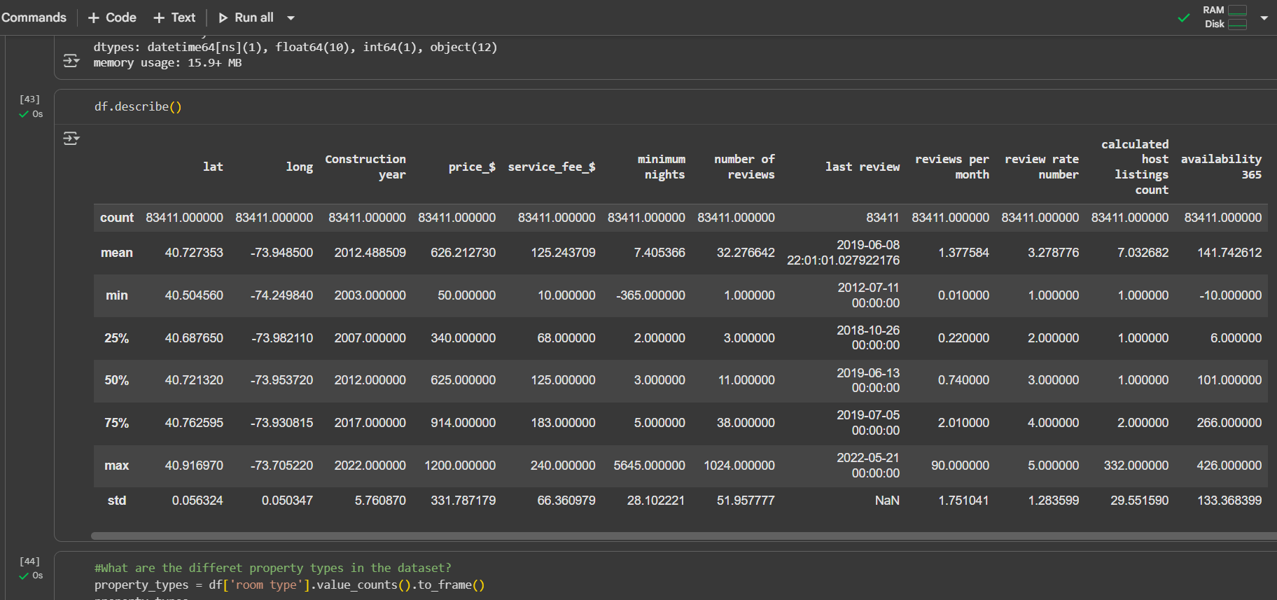
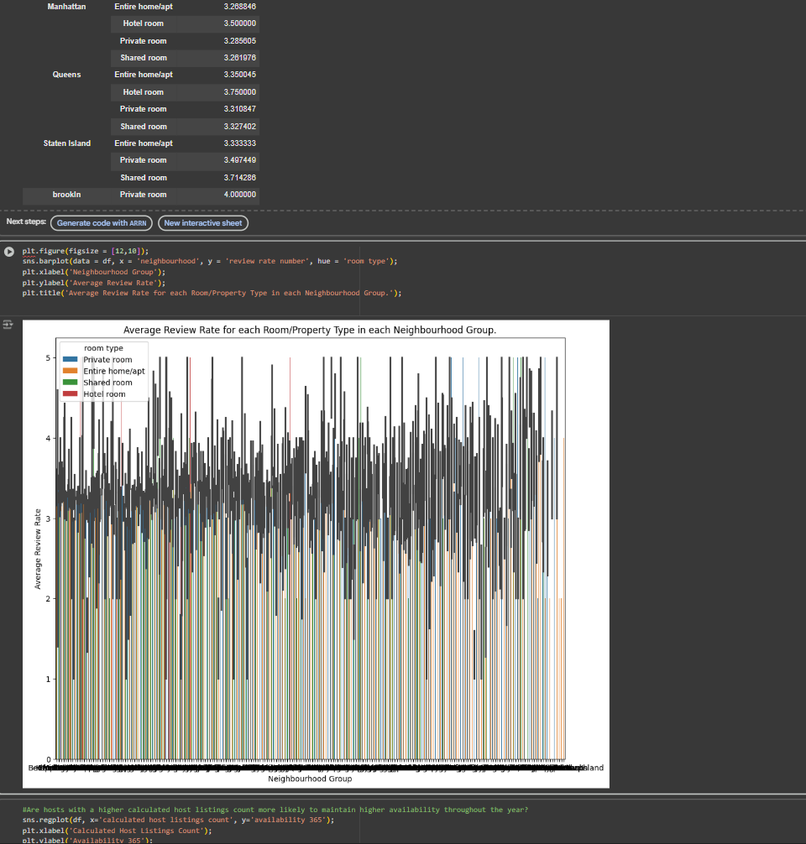
RESULTS3

Slide 9
GitHub repository
https://github.com/Nimisha2136/VOIS_AICTE_Oct2025_Nimisha-Rawat.git

Slide 10
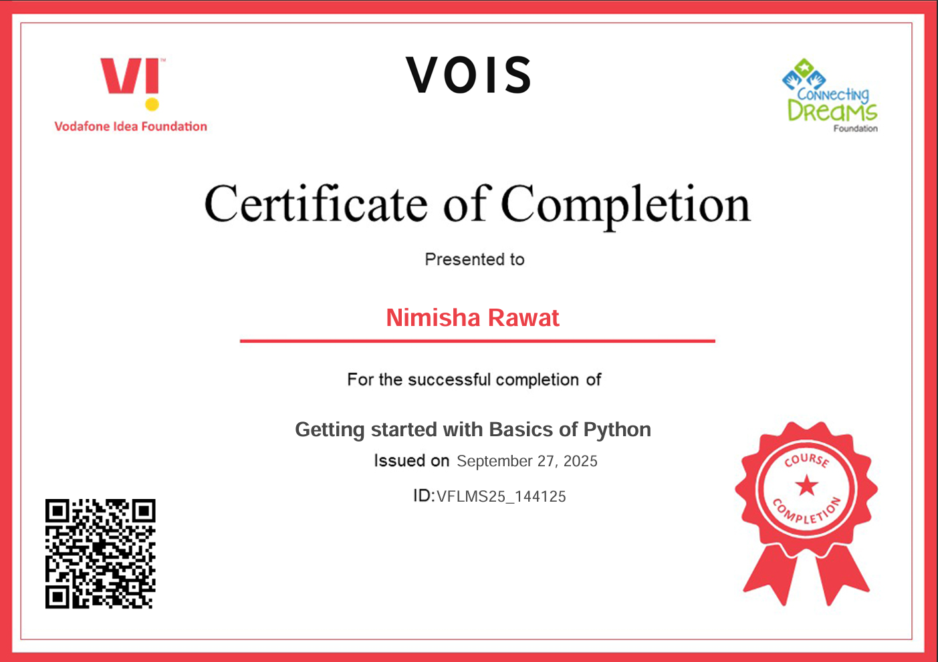
Getting started with Basics of Python Certificate

Slide 11
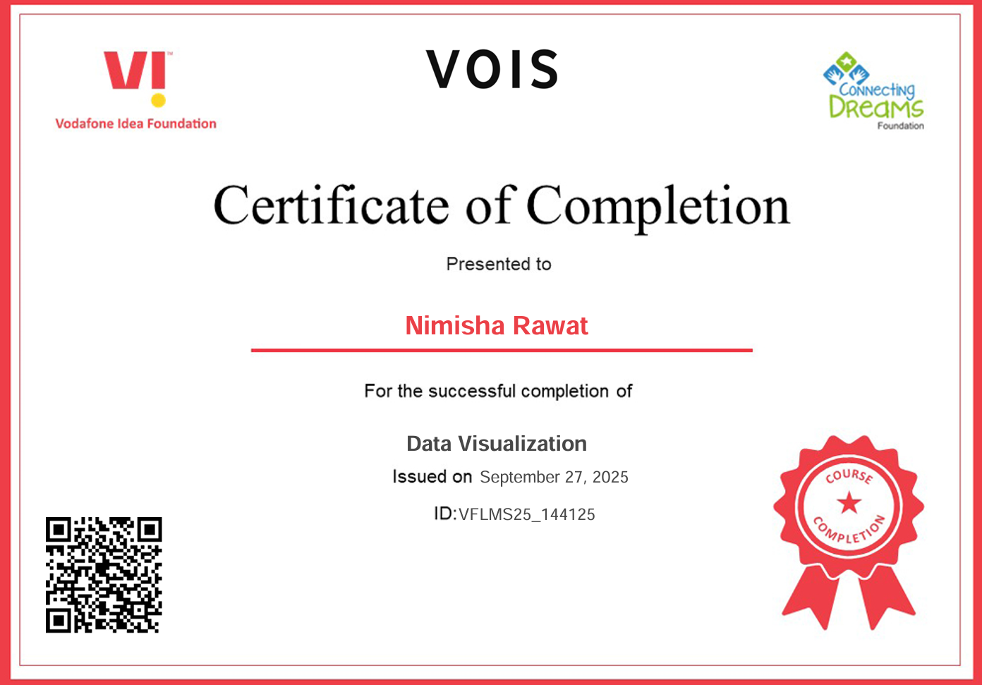
Data Visualization Certificate

Slide 12
Thank you
.
.

